Slide 1
ICT1205: DATABASE DESIGN AND APPLICATIONS
Lecture 05 (BSCS 1, BSDS 1)
Data Definition Language (DDL)
Mr. Peter Mulindwa
(MSc, BSc, CCNA)
Department of Computing & Technology
Faculty of Engineering, Design & Technology
15th February, 2024

Slide 2
Lecture Objectives and Learning outcomes
The Objective of this lecture is :
To understand the fundamental concepts of data definition using SQL.
To demonstrate the ability to use the CREATE statement to create database schemas

Slide 3
Create Database
To initialize a new database:
Syntax:
CREATE DATABASE database_name
There are numerous arguments that go along with this command but are database specific
© Department of Computing & Technology, Faculty of Engineering Design and Technology

Slide 4
Creating a Table
Syntax
CREATE TABLE table_name
(Column_name datatype[(size)],
Column_name datatype[(size)],
)
Example
CREATE TABLE books
(ISBN char(20),
Title char(50),
AuthorID Integer,
Price float)

Slide 5
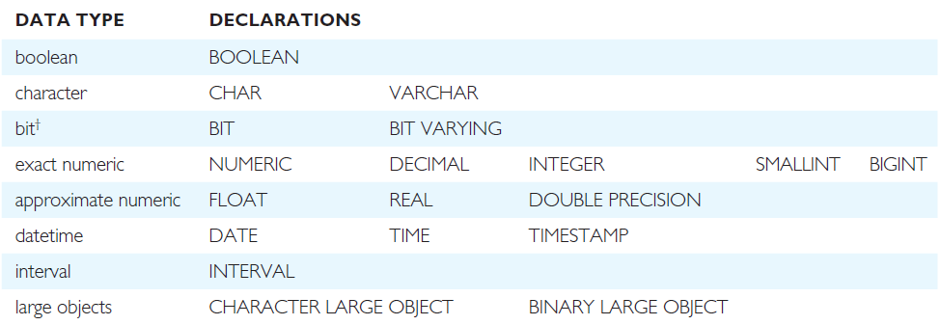
The ISO SQL Data Types

Slide 6
The ISO SQL Data Types
Boolean data: consists of the distinct truth values TRUE and FALSE
Character data: consists of a sequence of characters
The format for specifying a character data type is:
CHARACTER [VARYING] [length]
CHARACTER can be abbreviated to CHAR and
CHARACTER VARYING to VARCHAR.
Example: branchNo CHAR(4)
address VARCHAR(30)

Slide 7
Exact Numeric Data
Define numbers with an exact representation.
NUMERIC [ precision [, scale] ]
DECIMAL [ precision [, scale] ]
INTEGER
SMALLINT
BIGINT
INTEGER can be abbreviated to INT and DECIMAL to DEC
NUMERIC and DECIMAL store numbers in decimal notation. INT, SMALLINT & BIGINT Whole Numbers
Example: rooms SMALLINT
salary DECIMAL(7,2)

Slide 8
Large objects
A large object is a data type that holds a large amount of data, such as a long text file or a graphics file.
TYPES:
Binary Large Object (BLOB)
Character Large Object (CLOB)

Slide 9
Integrity Enhancement Feature
Consider five types of integrity constraints defined in CREATE & ALTER:
Required data
Domain constraints
Entity integrity
Referential integrity
General constraints.
Imposed in order to protect the database from becoming inconsistent

Slide 10
Integrity Enhancement Feature
1- Required Data
Null is used to represent data that is either not available, missing, or not applicable. When NOT NULL is specified, the system rejects any attempt to insert a null in the column. If NULL is specified, the system accepts nulls
Syntax:
columnName dataType [NOT NULL | NULL]
Example:
position VARCHAR(10) NOT NULL

Slide 11
Integrity Enhancement Feature
2- Domain Constraints
Every column has a domain, in other words a set of legal values.
(a) CHECK
Syntax:
CHECK (search condition)
Example:
sex CHAR NOT NULL
CHECK (sex IN (‘M’, ‘F’))
salary DECIMAL NOT NULL
CHECK (salary > 10000);
bno INT
CHECK (bno IN(SELECT branchno FROM branch))

Slide 12
2- Domain Constraints
Default Value:
A default value can be inserted in any column by using the Default keyword.
Example:
CREATE TABLE Movies (
movie_title VARCHAR(40) NOT NULL,
release_date DATE DEFAULT sysdate NULL,
genre VARCHAR(20) DEFAULT ‘Comedy’ CHECK genre IN (‘Comedy’, ‘Horror’, ‘Drama’)
)

Slide 13
3-Entity Integrity
Primary key of a table must contain a unique, non-null value for each row.
Syntax:
PRIMARY KEY(staffNo)
Example:
PRIMARY KEY(clientNo, propertyNo)
Can only have one PRIMARY KEY clause per table.
Can still ensure uniqueness for alternate keys using UNIQUE:
UNIQUE(telNo)
pno VARCHAR(5) NOT NULL UNIQUE;

Slide 14
4 - Referential Integrity
FK is column or set of columns that links each row in child table containing foreign FK to row of parent table containing matching PK.
Referential integrity means that, if FK contains a value, that value must refer to existing row in parent table.
- Syntax:
FOREIGN KEY (FK column (,…))
REFERENCES table_name [(CK column (,…))]
- Example:
FOREIGN KEY(bNo) REFERENCES Branch (branchNo)

Slide 15
4 - Referential Integrity
Any INSERT/UPDATE attempting to create FK value in child table without matching CK value in parent is rejected.
Action taken attempting to update/delete a CK value in parent table with matching rows in child is dependent on referential action specified using ON UPDATE and ON DELETE subclauses:
Syntax:
FOREIGN KEY (FK column (,…) )
REFERENCES tablename [ ( CK column(,…)) ]
[ON UPDATE[CASCADE|SET NULL|SET DEFAULT|NO ACTION]]
[ON DELETE[CASCADE|SET NULL|SET DEFAULT|NO ACTION]]

Slide 16
4 - Referential Integrity
Four options are supported when the user attempt to delete or update a CK, & there are matching FKs:
CASCADE: automatically delete/update the CK row & all matching (FKs) rows in child table.
SET NULL: delete/update the CK row & set the FK values to NULL. Valid only if NOT NULL clause is not specified for the FK.
SET DEFAULT: delete/update the CK row & set the FK values to default. Valid only if DEFAULT clause is specified for the FK.
NO ACTION: rejects the delete/update operation.

Slide 17
4 - Referential Integrity
Examples:
FOREIGN KEY (staffNo) REFERENCES Staff ON DELETE SET NULL
FOREIGN KEY (ownerNo) REFERENCES Owner ON UPDATE CASCADE

Slide 18
Create a table
CREATE TABLE TableName
{(columName dataType [NOT NULL] [UNIQUE]
[DEFAULT defaultOption] [CHECK (searchCondition)] [, . . .]}
[PRIMARY KEY (listOfColumns),]
{[UNIQUE (listOfColumns)] [, . . .]}
{[FOREIGN KEY (listOfForeignKeyColumns)
REFERENCES ParentTableName [(listOfCandidateKeyColumns)]
[MATCH {PARTIAL | FULL}
[ON UPDATE referentialAction]
[ON DELETE referentialAction]] [, . . .]}
{[CHECK (searchCondition)] [, . . .]})
© Department of Computing & Technology, Faculty of Engineering Design and Technology

Slide 19
Example 1 - CREATE TABLE
DEPARTMENT( Dname, Dnumber)
CREATE TABLE department ( Dname VARCHAR(15) NOT NULL,
Dnumber INT NOT NULL,
PRIMARY KEY (Dnumber),
UNIQUE (Dname),
CHECK (Dname NOT LIKE ‘% Inc.’
AND Dnumber >70));

Slide 20
The definition of the ALTER TABLE statement in the ISO standard consists of these;
Alter table
Add a new column to a table;
Drop a column from a table;
Add a new table constraint;
Drop a table constraint;
Set a default for a column;
Drop a default for a column.
© Department of Computing & Technology, Faculty of Engineering Design and Technology

Slide 21
Alter table
ALTER TABLE TableName
[ADD [COLUMN] columnName dataType [NOT NULL] [UNIQUE]
[DEFAULT defaultOption] [CHECK (searchCondition)]]
[DROP [COLUMN] columnName [RESTRICT | CASCADE]]
[ADD [CONSTRAINT [ConstraintName]] tableConstraintDefinition]
[DROP CONSTRAINT ConstraintName [RESTRICT | CASCADE]]
[ALTER [COLUMN] SET DEFAULT defaultOption]
[ALTER [COLUMN] DROP DEFAULT]
© Department of Computing & Technology, Faculty of Engineering Design and Technology

Slide 22
Alter table
Remove constraint from PropertyForRent that staff are not allowed to handle more than 100 properties at a time.
ALTER TABLE PropertyForRent
DROP CONSTRAINT StaffNotHandlingTooMuch;
Change the staff table by making the salary must be >10000
ALTER TABLE Staff
ADD CONSTRAINT StaffSalary
CHECK( Salary >10000)

Slide 23
Alter table
Add new column to Client table.
ALTER TABLE Client
ADD prefNoRooms PRooms;
Remove the city attribute from the client table.
ALTER TABLE Client
Drop City;

Slide 24
Alter table
Change Staff table by removing default of ‘Assistant’ for position column and setting default for sex column to female (‘F’).
ALTER TABLE Staff
ALTER position DROP DEFAULT;
ALTER TABLE Staff
ALTER sex SET DEFAULT ‘F’;

Slide 25
DROP TABLE
- Syntax:
DROP TABLE TableName [RESTRICT | CASCADE]
- Example:
DROP TABLE PropertyForRent;
Removes named table and all rows within it.
With RESTRICT, if any other objects depend for their existence on continued existence of this table, SQL does not allow request.
With CASCADE, SQL drops all dependent objects (and objects dependent on these objects).

Slide 26
Data Definition Language
The SQL DDL allows database objects such as schemas, domains, tables, views, and indexes to be created and destroyed.
The main SQL data definition language statements are:
CREATE SCHEMA, DROP SCHEMA
CREATE DOMAIN, ALTER DOMAIN, DROP DOMAIN
CREATE TABLE, ALTER TABLE, DROP TABLE
CREATE VIEW, DROP VIEW
© Department of Computing & Technology, Faculty of Engineering Design and Technology

